Slide 1
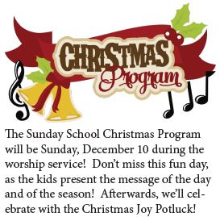
Christmas Joy Offering collected Dec. 17th.

